Slide 1
Hibernate 4.0

Slide 2
Hibernate 4
Open source java persistence framework.
Great tool for ORM mapping in java.
Query database using HQL and SQL.

Slide 3
Mapping java classes
Configuration of XML file.
Java Annotation.

Slide 4
How Hibernate Works
Some Annotations telling hibernate that how to use them when mapping them with database and in runtime use these annotations to build queries.

Slide 5
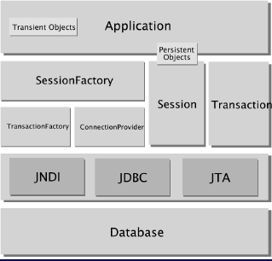
Hibernate Architecture

Slide 6
Transient Objects:
Instances of persistent classes that are not currently associated with a Session. They may have been instantiated by the application and not yet persisted, or they may have been instantiated by a closed Session.
Persistent objects:
Short-lived, single threaded objects containing persistent state and business function. These can be ordinary Java Beans/POJOs. They are associated with exactly one Session. Once the Session is closed, they will be detached and free to use in any application layer (for example, directly as data transfer objects to and from presentation).
SessionFactory:
A thread safe, immutable cache of compiled mappings for a single database. A factory for Session and a client of ConnectionProvider, SessionFactory can hold an optional (second-level) cache of data that is reusable between transactions at a process, or cluster, level.

Slide 7
Session:
A single-threaded, short-lived object representing a conversation between the application and the persistent store. It wraps a JDBC connection and is a factory for Transaction. Session holds a mandatory first-level cache of persistent objects that are used when navigating the object graph or looking up objects by identifier.
TransactionFactory:
(Optional) A factory for Transaction instances. It is not exposed to the application, but it can be extended and/or implemented by the developer.
ConnectionProvider:
(Optional) A factory for, and pool of, JDBC connections. It abstracts the application from underlying Data source or DriverManager. It is not exposed to application, but it can be extended and/or implemented by the developer.
Transaction:
(Optional) A single-threaded, short-lived object used by the application to specify atomic units of work. It abstracts the application from the underlying JDBC, JTA or CORBA transaction. A Session might span several Transactions in some cases. However, transaction demarcation, either using the underlying API or Transaction, is never optional.

Slide 8
How to build SessionFactory
Deprecated classes are AnnotationConfiguration, ServiceRegistryBuilder
building hibernate SessionFactory without using deprecated classes.
Hibernate 4.3.6.Final.
Classes used in building SessionFactory
Configuration : In place of deprecated AnnotationConfiguration
StandardServiceRegistryBuilder : In place of deprecated ServiceRegistryBuilder

Slide 9
import java.io.File;
import org.hibernate.SessionFactory;
import org.hibernate.cfg.AnnotationConfiguration;
public class HibernateUtil {
private static final SessionFactory sessionFactory = buildSessionFactory();
private static SessionFactory buildSessionFactory() {
try {
// Create the SessionFactory from hibernate.cfg.xml
return new AnnotationConfiguration().configure(new File("hibernate.cgf.xml")).buildSessionFactory();
} catch (Throwable ex) {
// Make sure you log the exception, as it might be swallowed
System.err.println("Initial SessionFactory creation failed." + ex);
throw new ExceptionInInitializerError(ex);
}
}
public static SessionFactory getSessionFactory() {
return sessionFactory;
}
public static void shutdown() {
// Close caches and connection pools
getSessionFactory().close();
}
}

Slide 10
Configuration configuration = new Configuration().configure(HibernateUtil.class.getResource("/hibernate.cfg.xml"));
StandardServiceRegistryBuilder serviceRegistryBuilder = new StandardServiceRegistryBuilder();
serviceRegistryBuilder.applySettings(configuration.getProperties());
ServiceRegistry serviceRegistry = serviceRegistryBuilder.build();
sessionFactory = configuration.buildSessionFactory(serviceRegistry);

Slide 11
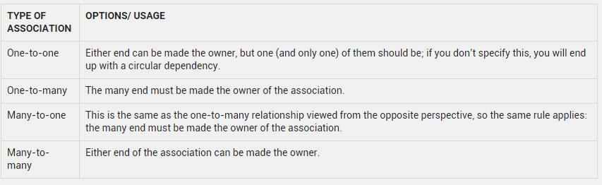
Associations for Various Mappings

Slide 12
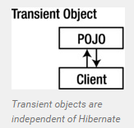
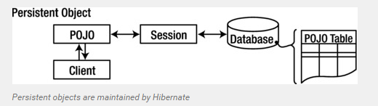
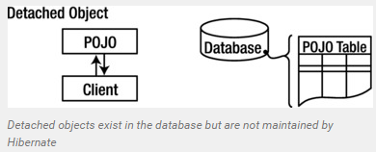
Hibernate Entity / Persistence LifeCycle States
4 states
-> Transient
-> Persistent
(Hibernate manages the persistence f
or persistent objects)
-> Detached
-> removed

Slide 13
Contd..
Newly created POJO object will be in the transient state. Transient object doesn’t represent any row of the database i.e. not associated with any session object. It’s plain simple java object.
Persistent object represent one row of the database and always associated with some unique hibernate session. Changes to persistent objects are tracked by hibernate and are saved into database when commit call happen.
Detached objects are those who were once persistent in past, and now they are no longer persistent. To persist changes done in detached objects, you must reattach them to hibernate session.
Removed objects are persistent objects that have been passed to the session’s remove() method and soon will be deleted as soon as changes held in the session will be committed to database.

Slide 14
Hibernate JPA Cascade Types
To save the mapped entity whenever relationship owner entity got saved.
Example : Employee Table
(Employee Table)
@OneToMany(cascade=CascadeType.ALL, fetch = FetchType.LAZY)
@JoinColumn(name="EMPLOYEE_ID")
private Set<AccountEntity> accounts;
Account Table
@OneToOne (mappedBy="accounts", fetch = FetchType.LAZY)
private EmployeeEntity employee;
(It defines “cascade=CascadeType.ALL” and it essentially means that any change happened on EmployeeEntity must cascade to AccountEntity as well.)
If you save an employee, then all associated accounts will also be saved into database. If you delete an Employee then all accounts associated with that Employee also be deleted.

Slide 15
JPA Cascade Types
only save operations but not delete operation.
@OneToMany(cascade=CascadeType.PERSIST, fetch = FetchType.LAZY)
@JoinColumn(name="EMPLOYEE_ID")
private Set<AccountEntity> accounts;
CascadeType.PERSIST : means that save() or persist() operations cascade to related entities.
CascadeType.MERGE : means that related entities are merged into managed state when the owning entity is merged.
CascadeType.REFRESH : does the same thing for the refresh() operation.
CascadeType.REMOVE : removes all related entities association with this setting when the owning entity is deleted.
CascadeType.DETACH : detaches all related entities if a “manual detach” occurs.
CascadeType.ALL : is shorthand for all of the above cascade operations.

Slide 16
orphanRemoval = true
(Hibernate Specific Cascade Types)
@OneToMany(orphanRemoval = true, mappedBy = "employee")
private Set<AccountEntity> accounts;
whenever I will remove an ‘account from accounts set’ (which means I am removing the relationship between that account and Employee); the account entity which is not associated with any other Employee on database (i.e. orphan) should also be deleted.
//Load the employee in another session
EmployeeEntity employee = (EmployeeEntity) sessionOne.load(EmployeeEntity.class, 1);
//Verify there are 3 accounts
System.out.println("Step 1 : " + employee.getAccounts().size());
//Remove an account from first position of collection
employee.getAccounts().remove(employee.getAccounts().iterator().next());

Slide 17
http://howtodoinjava.com/2014/09/05/how-to-define-association-mappings-between-hibernate-entities/

